Slide 1

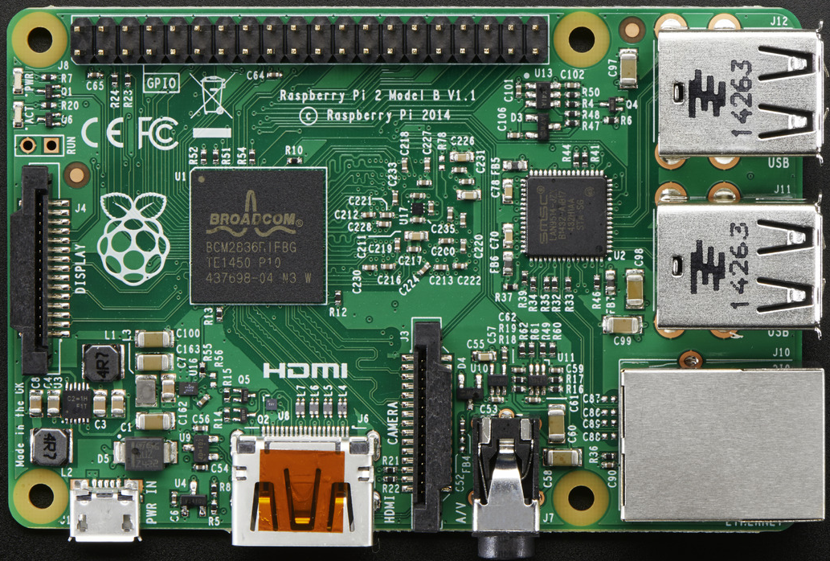
Benchmarking Linux Operating Systems for the Raspberry Pi 2
John Bellows
Advisor Dr. Zhang
Computer Science Department
Introduction
From its introduction, the Raspberry Pi (RPi) single-board computer (SBC) has been incredibly popular, sold millions of units, and inspired a range of similar small form factor SBC’s. A driving force behind the popularity of the RPi is its low cost ($35) and use of open-source software, including operating systems. In traditional computing the choice of operating system, especially in the case of open-source, can largely be a matter of personal preference. However, given the limited hardware capabilities of the RPi the efficient use of resources by the operating system is particularly important.
Method
This project tests process management, memory management, and secondary storage management with open source synthetic benchmark tools.
 | Arch | Debian | Fedora | Ubuntu
OS Version | Arch Linux ARM | Debian GNU/Linux 8 | Fedora 23 | Ubuntu 14.04
Kernel | 4.1.20-3 ARCH | 3.18.0 trunk-rpi2 | 3.18.0-20 rpi2 | 4.1.20-v7+
Compiler | GCC 5.3.0 | GCC 4.92 | GCC 4.8 | GCC 5.3.1
Processor Speed | 0.90GHz | 0.80GHz | 0.90GHz | 0.90GHz
Package Manager | Pacman | Apt-get | Dnf | Apt-get
Memory | 922MB | 925MB | 925MB | 923MB
Figure 1. Benchmarks Results for Processor Time
Table 4. System Information of Tested Operating Systems
Results
Arch is known for being a simple Linux distribution, but under performed compared to Debian and Fedora. In fact Debian and Fedora Linux showed significant advantages over Arch and Ubuntu. In the RAMSpeed test Fedora showed significantly improved memory access times over the other operating systems, while in the Dbench and Iozone tests, Debian produced superior disk access times. The processor times for the build Linux kernel and PHPbench tests were inconclusive as all operating systems performed similarly. No one operating system clearly outperformed the others, leading to the rejection of the hypothesis.
Hypothesis
Arch Linux ARM has faster disk access, memory requests, and processing time than other operating systems. The following metrics are measured:
1. Disk access: How quickly critical information is retrieved.
2. Memory access: Ability to handle requests under high memory loads.
3. Processor time: Measure the degradation of CPU performance under heavy computation.
Figure 2. Benchmarks Results for Memory Access
Figure 3. Benchmarks Results for Disk Access

